Slide 1

Doctor and Patient Portal
Under the guidance of:
Ms. Raheela Tabassum
Assistant Professor
(CSE-AI&ML)
Presented by:
Mohammed Salman Naveed-160921748015
Aasim Ansari-160921748039
Amaan Ahmed-160921748043

Slide 2
Overview
01
05
09
Conclusion
Introduction
System Requirements
02
Abstract
06
Methodology
10
Future Scope
03
Existing System
07
Implementation
04
Proposed System
08
Result

Slide 3
Introduction
In large hospitals, massive staff members and doctors are present. Efficient management of time and scheduling of tasks becomes a very tough task.
At present, a person sick from any disease needs to visit the hospital to book an appointment. All the patients need to wait in a queue while getting an appointment. Managing the time, schedule and proper regularity of tasks becomes very difficult.

Slide 4
In order to have efficient and effective system of doctor-patient interactions, a doctor patient handling and managing system should be designed that not only assists the doctors in their work but also helps patients in numerous ways like booking doctor's appointments and assessing medical reports and progress of treatment

Slide 5
Abstract
Patient benefits:
Access medical records
Schedule appointments
Secure messaging with doctors
Doctor benefits:
Streamlined patient management
Easy access to records

Slide 6
Existing System
Existing System
Manual appointment booking
Paper-based medical records
Physical presence required for appointments and record-keeping
High workload for doctors and staff
Disadvantages
Time-Consuming:
Inconvenient Scheduling:
Limited Availability:

Slide 7
Proposed System
Online appointment booking and medical history access for patients
Remote access to patient records and appointment management for doctors
Electronic prescription system, eliminating paper prescriptions
Secure and encrypted storage of patient data, protecting against unauthorized access

Slide 8
Advantages of Proposed System
Easy Record Access:
Simple Appointments:
Quick Messages:
Reminders:
Time-Saving:
24/7 Access:
Health Info:

Slide 9
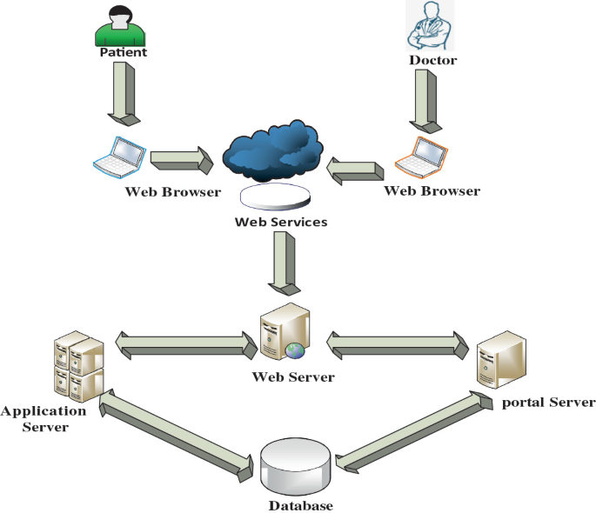
System Architecture

Slide 10
System Requirements
HARDWARE REQUIREMENTS:
SOFTWARE REQUIREMENTS:
Processor: Pentium IV or higher
RAM: 256 MB
Space on Hard Disk: minimum 512MB
Operating Systems supported
Windows
Technologies and Languages used to Develop
Python
Django

Slide 11
Methodology used
Design Science Research (DSR): focused on designing and developing a solution to solve a real-world problem.
System Development Life Cycle (SDLC): a framework for planning, designing, developing, testing, and deploying the online platform.
3. User-Centered Design (UCD): prioritizing the needs and experiences of patients and doctors in the design and development process.

Slide 12
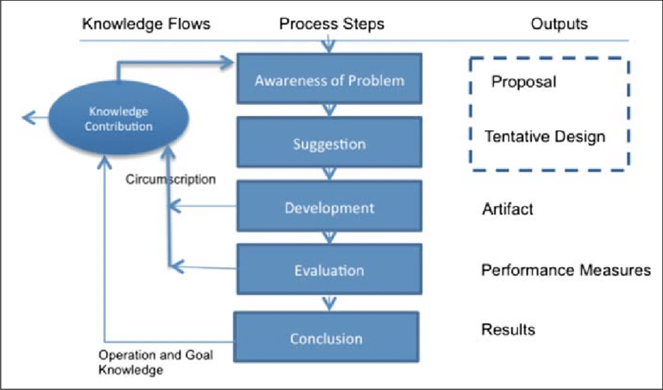
Methodology
Design Science Research (DSR):
Identifies and defines real-world problems
Designs and develops innovative solutions
Evaluates and refines solutions through iteration

Slide 13
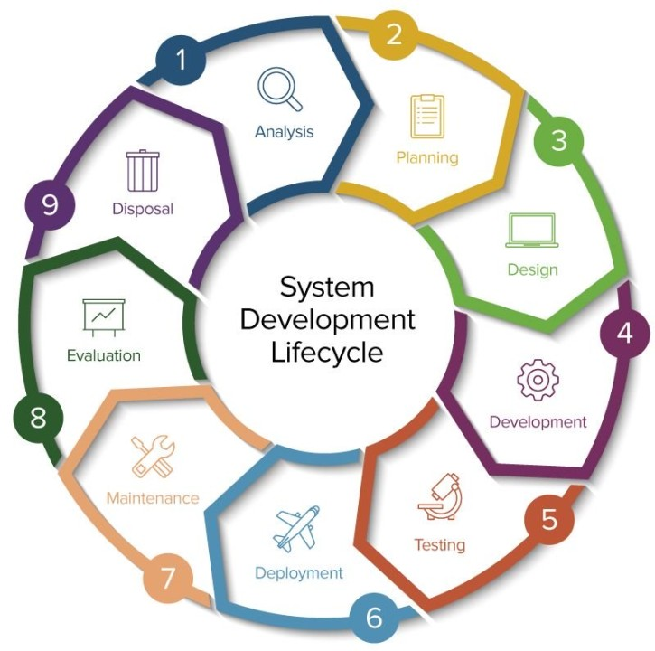
Methodology
System Development Life Cycle (SDLC):
Planning
Analysis
Design
Implementation
Testing
Deployment
Maintenance

Slide 14
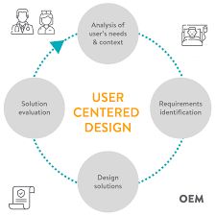
Methodology
User-Centered Design (UCD):
Focus on users' needs and experiences
Empathize with patients and doctor
Understand their goals, behaviors, and motivations
Design solutions that meet their needs
Test and refine with user feedback

Slide 15
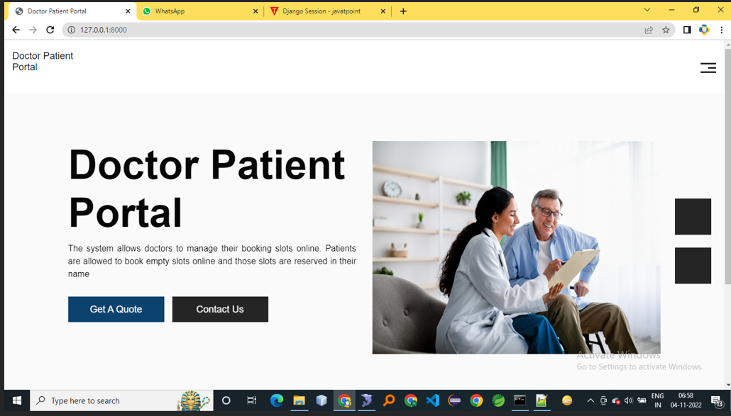
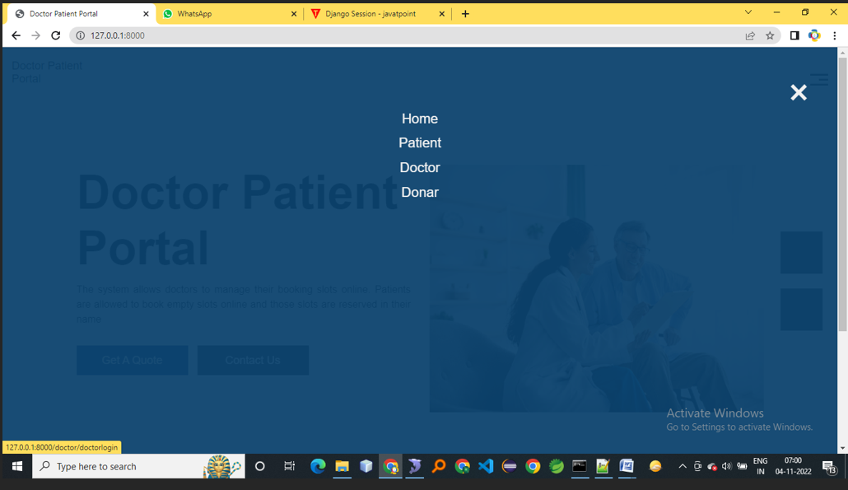
Result
Doctor and patient portal
main page
Home page

Slide 16
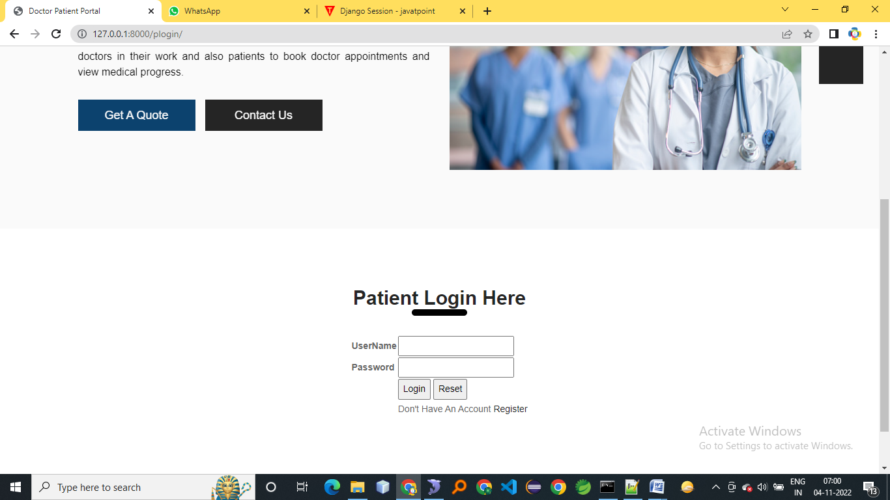
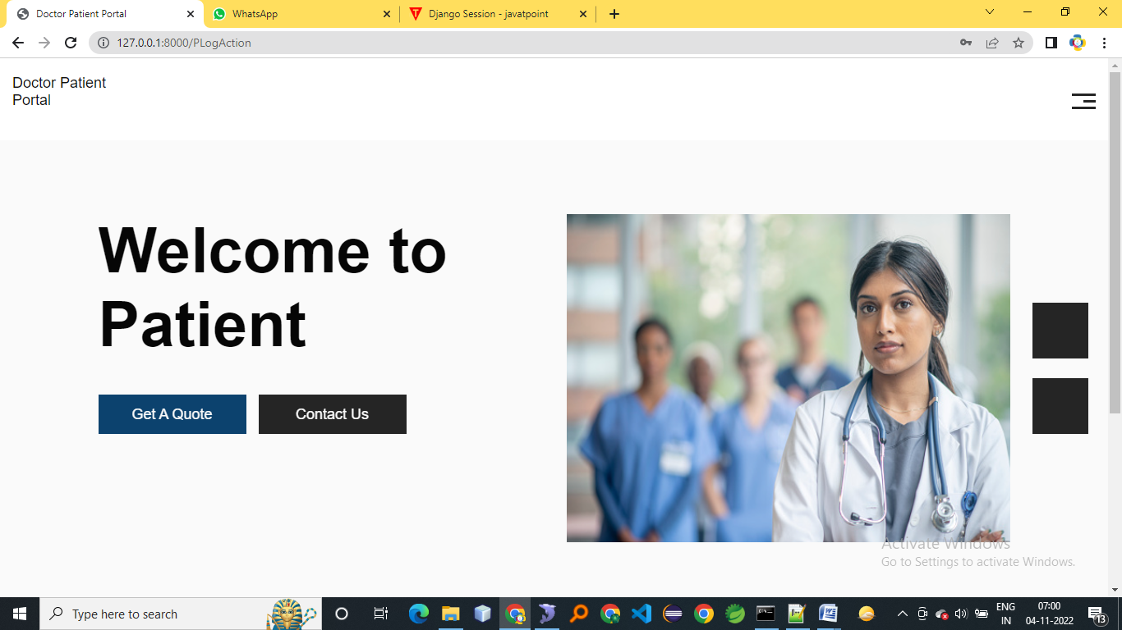
Result
PATIENT LOGIN
PATIENT HOME

Slide 17
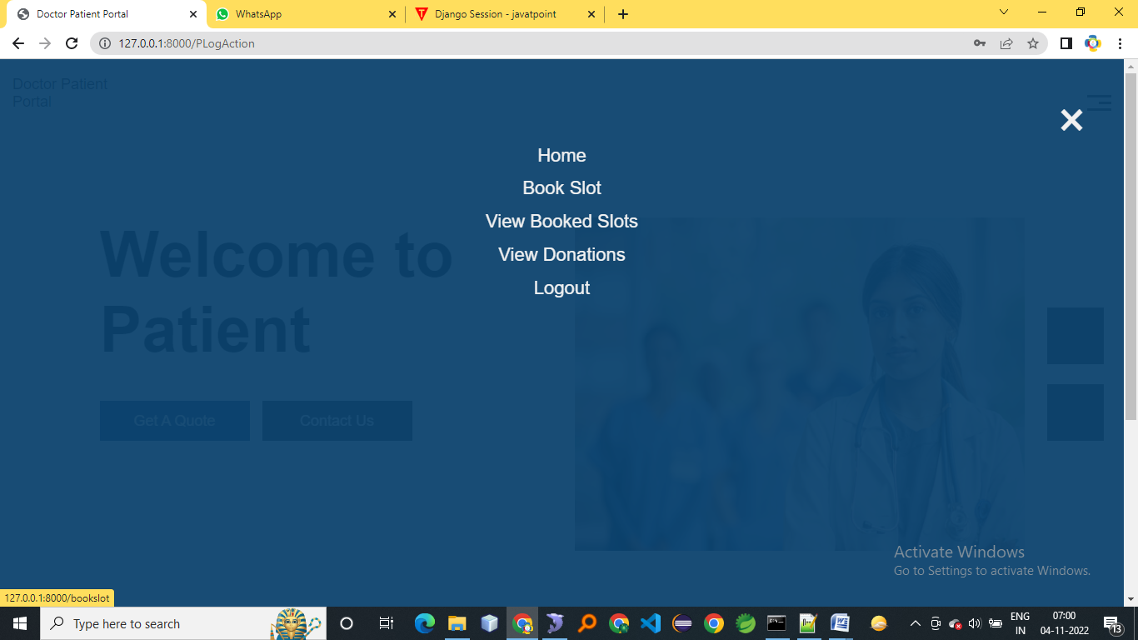
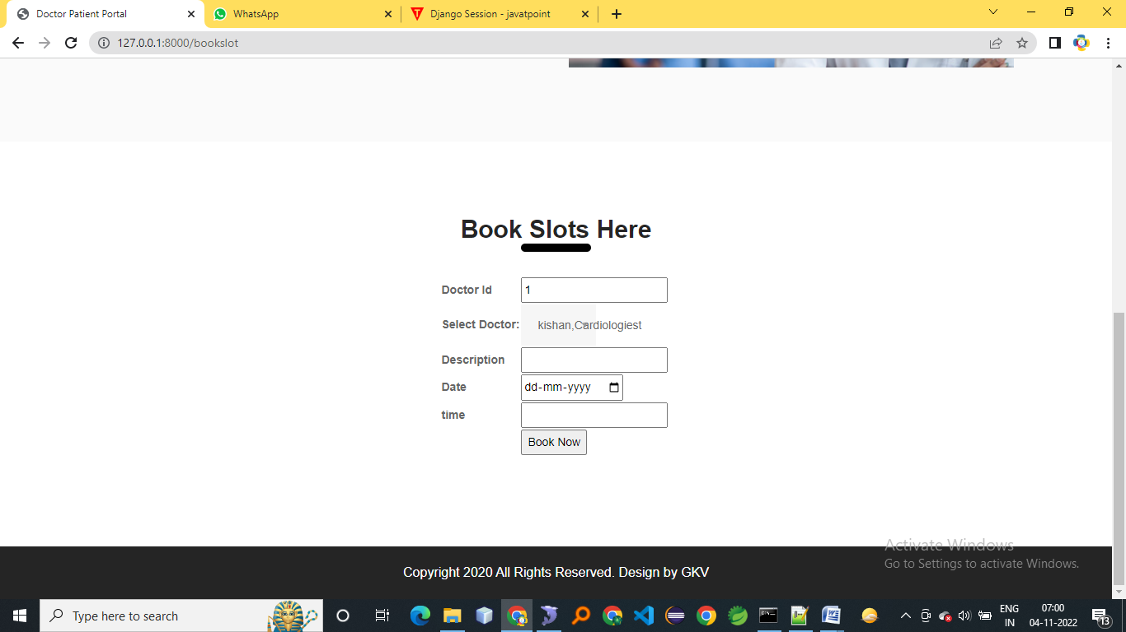
Result
PATIENT LINKS
BOOK SLOTS

Slide 18
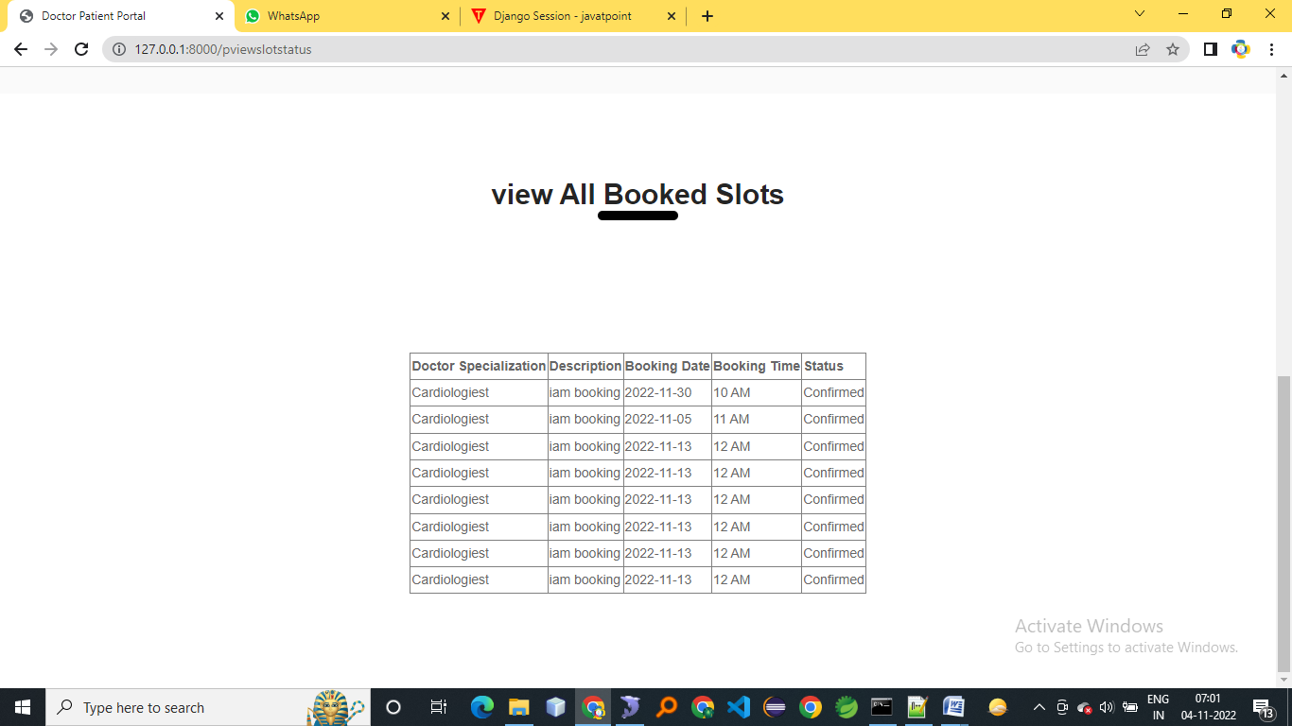
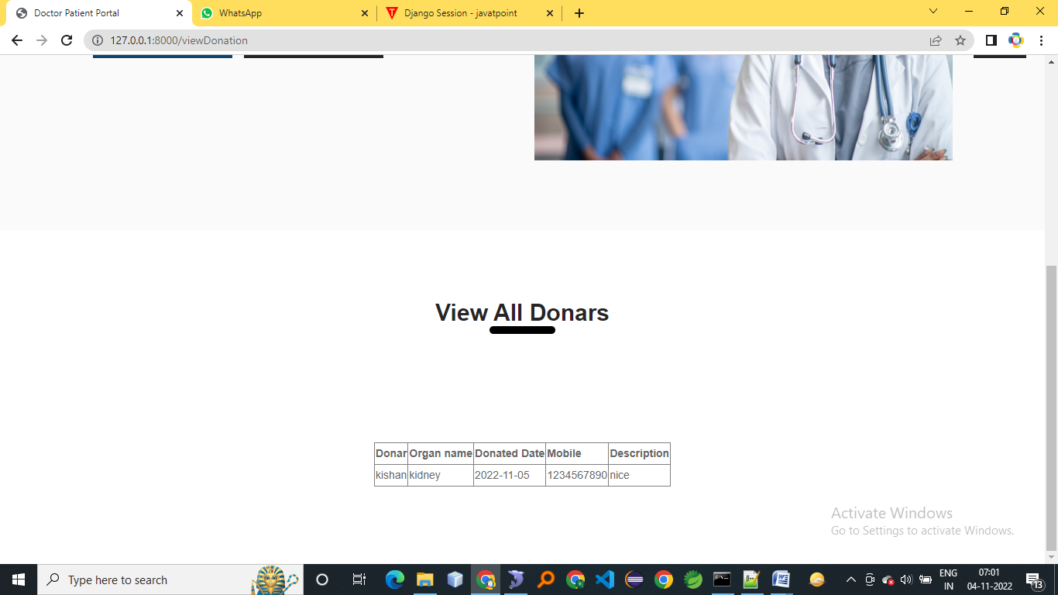
Result
VIEW BOOKED SLOTS
VIEW DONATIONS

Slide 19
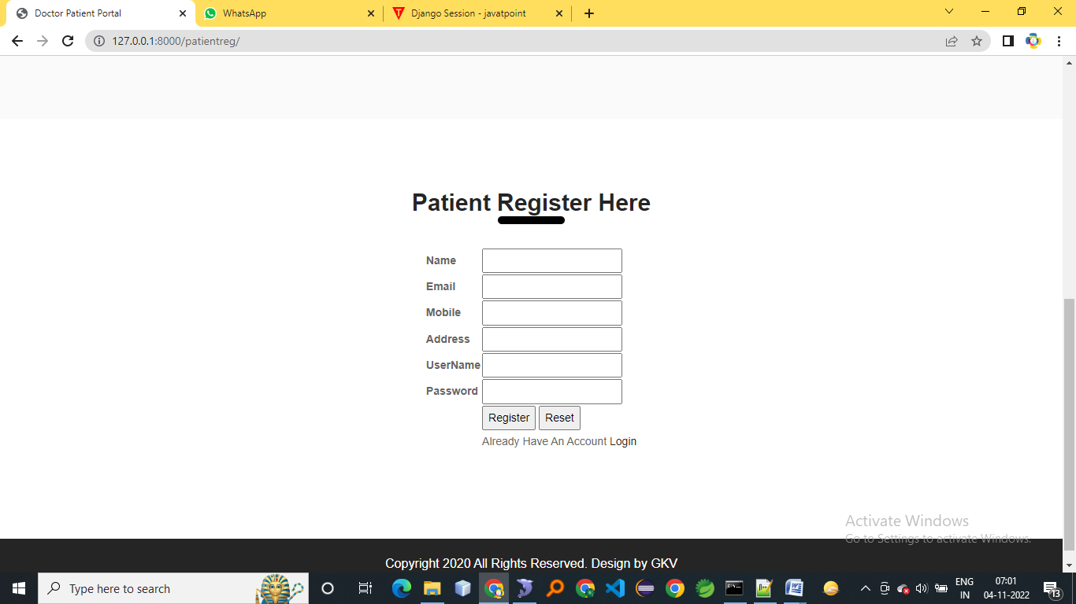
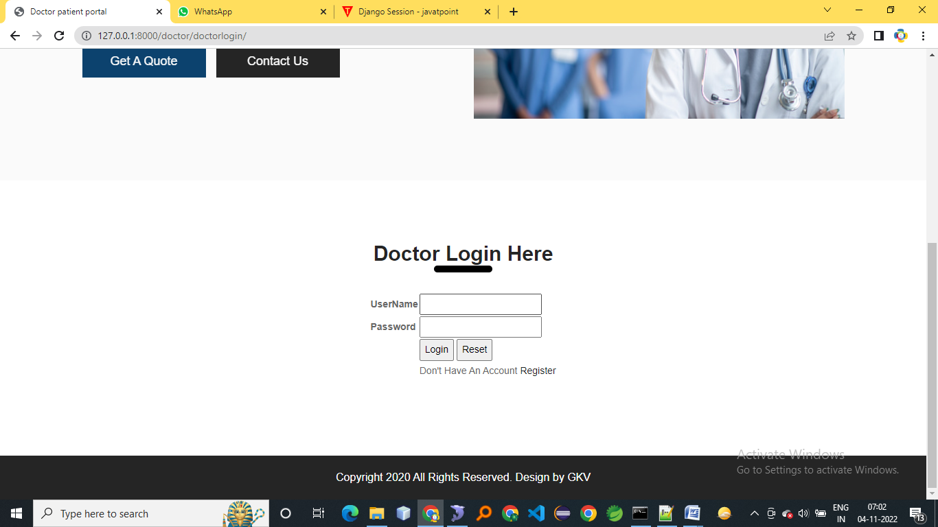
Result
PATIENT REGISTRATION
DOCTOR LOGIN

Slide 20
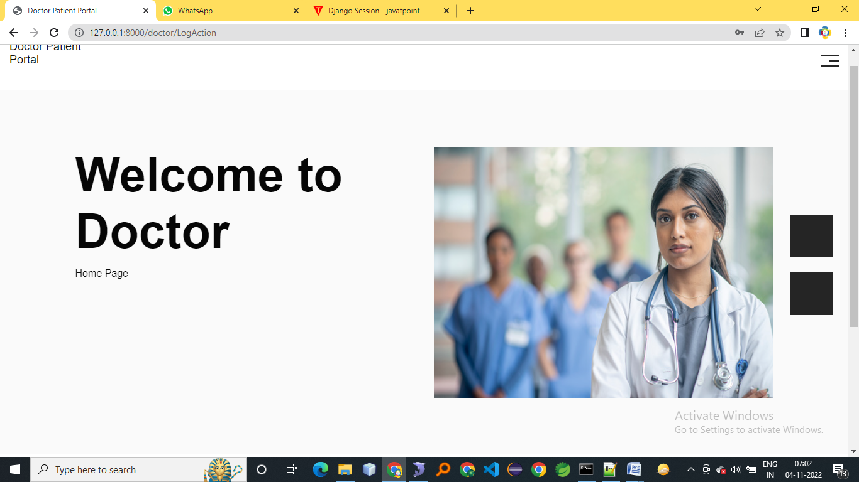
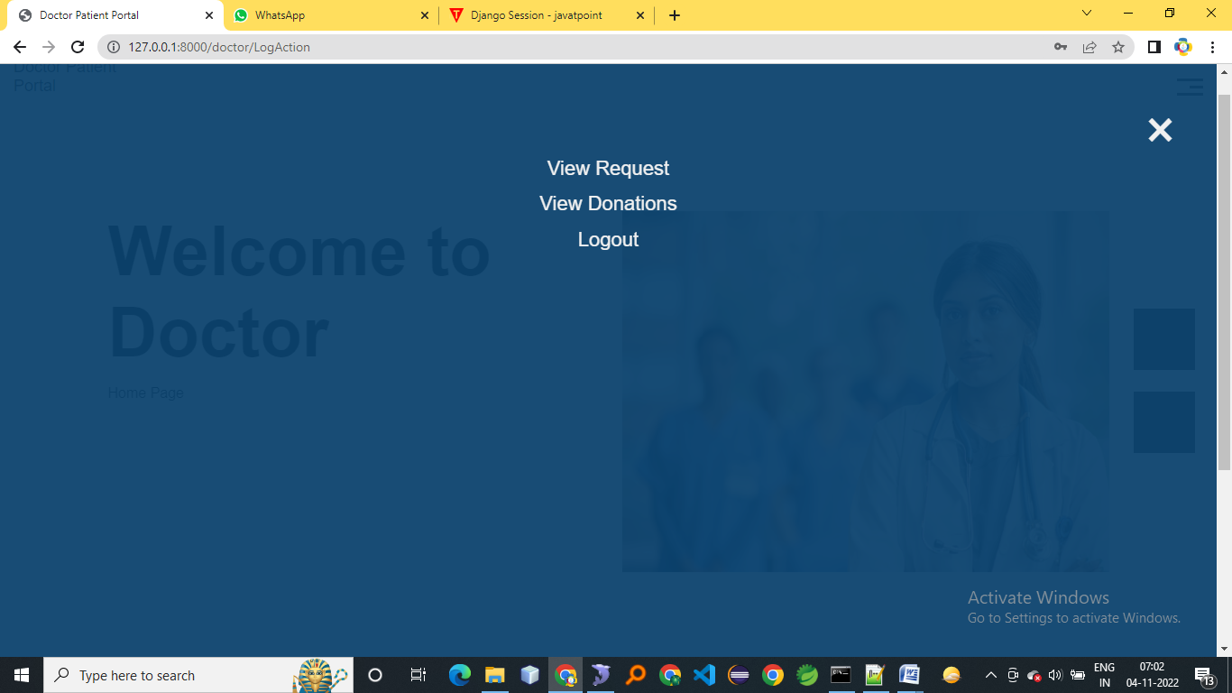
Result
DOCTOR HOME
DOCTOR LINKS

Slide 21
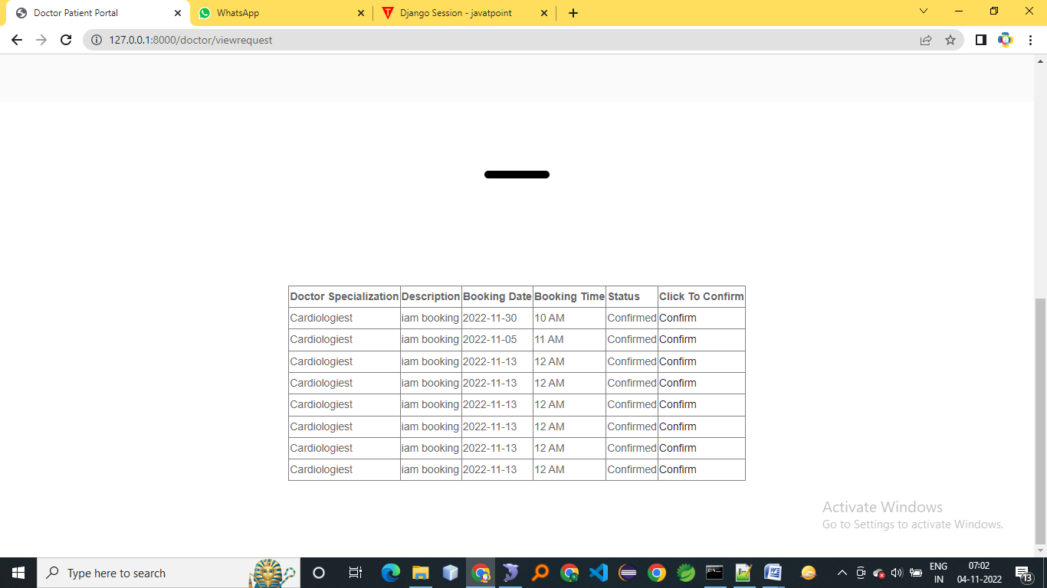
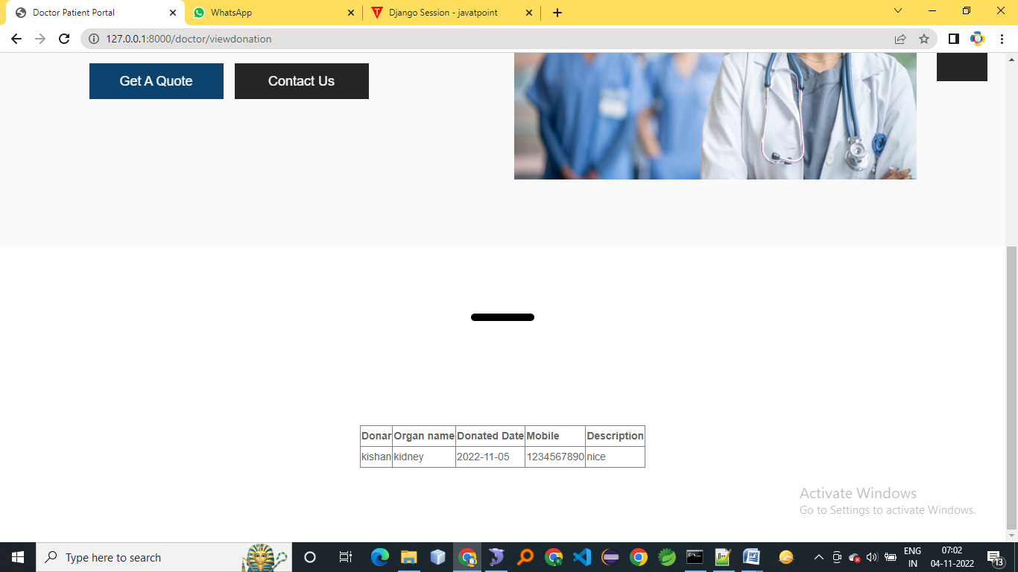
Result
VIEW SLOT BOOKING REQUESTS
VIEW DONATIONS

Slide 22
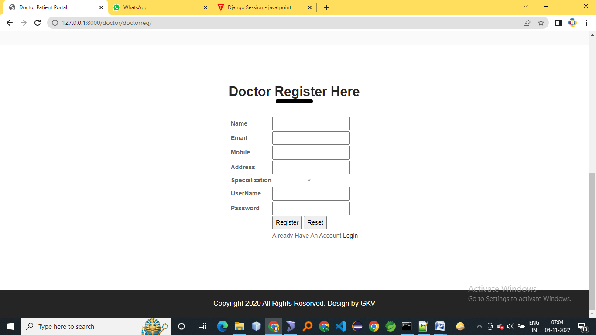

Result
DOCTOR REGISTRATION
DONAR LOGIN

Slide 23
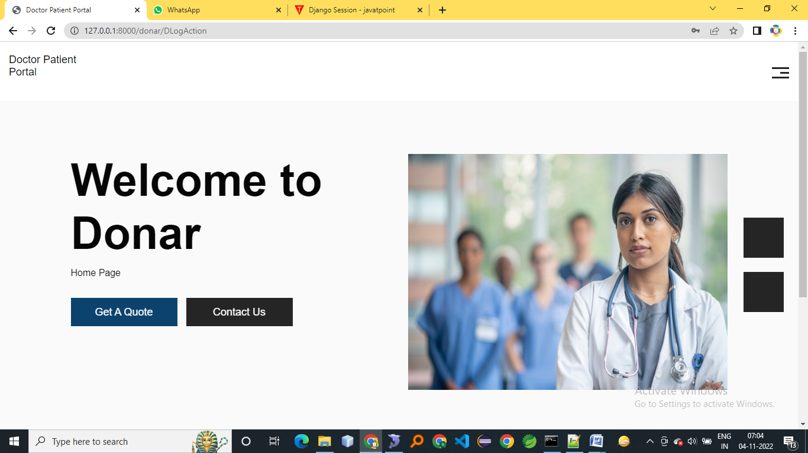
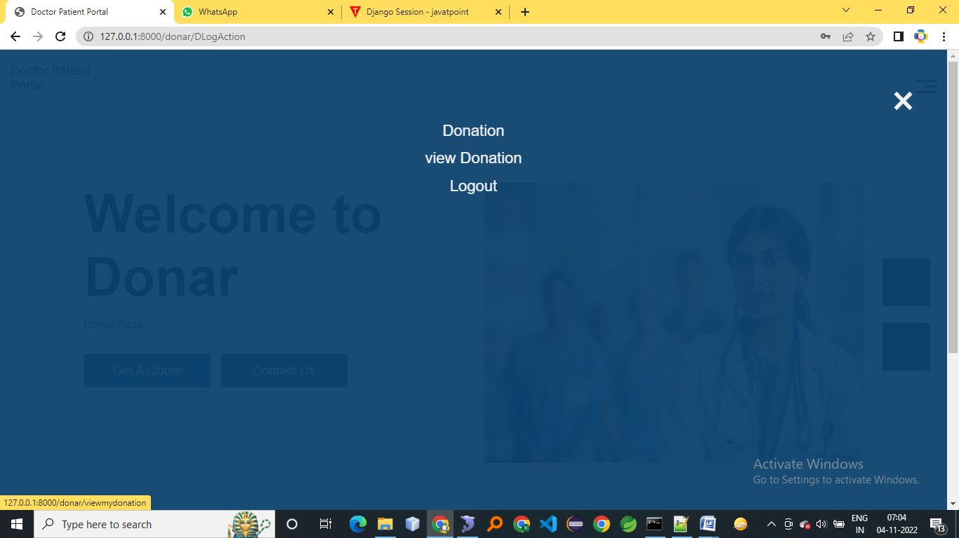
Result
DONAR HOME PAGE
DONAR LINKS

Slide 24
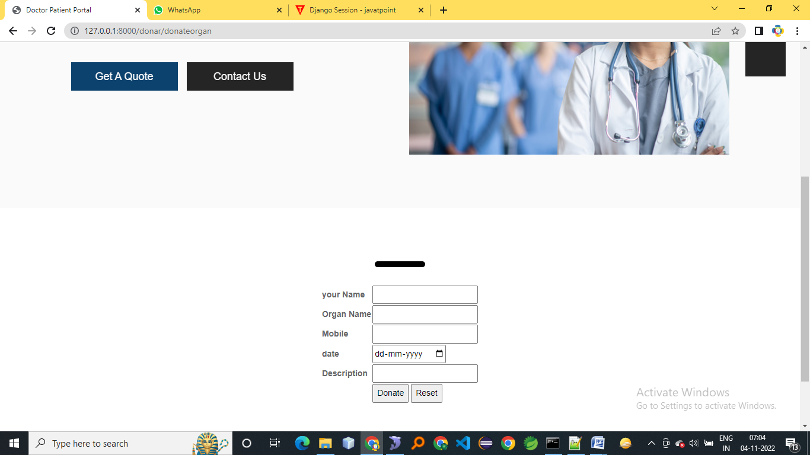
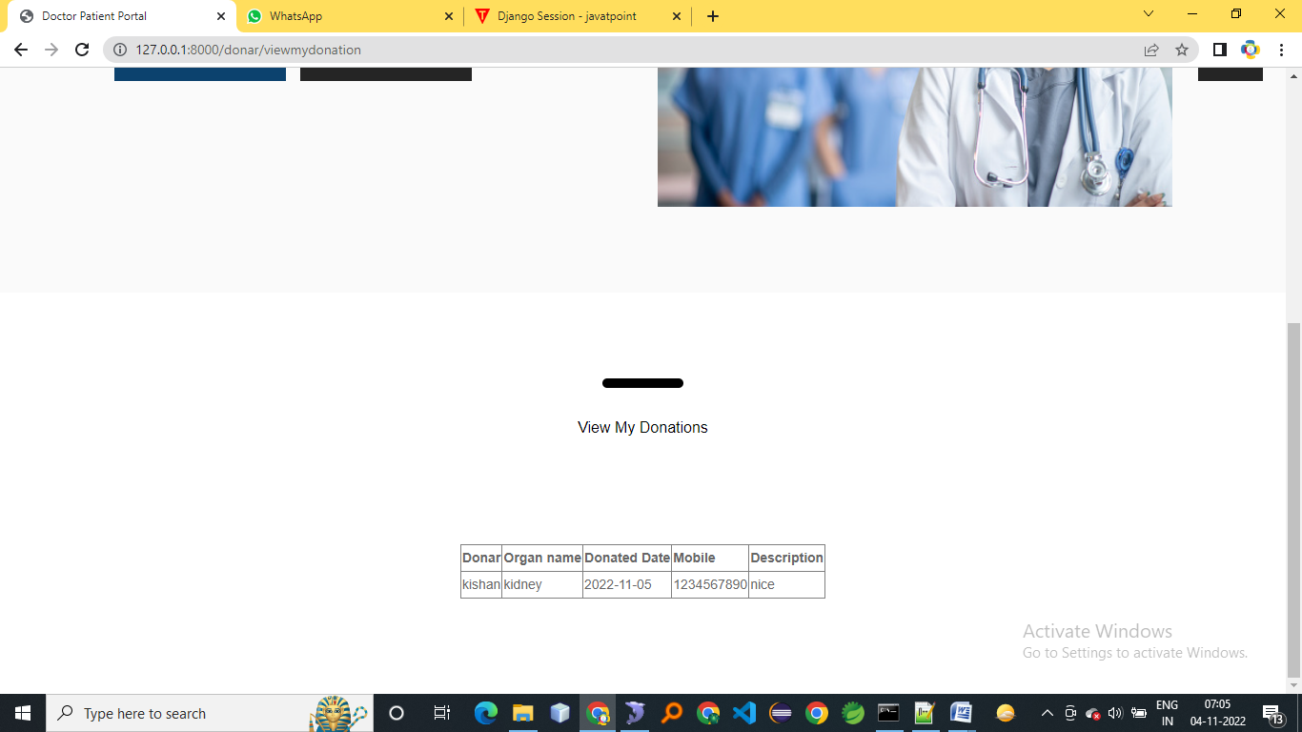
Result
DONATE ORGAN PAGE
VIEW DONATIONS

Slide 25
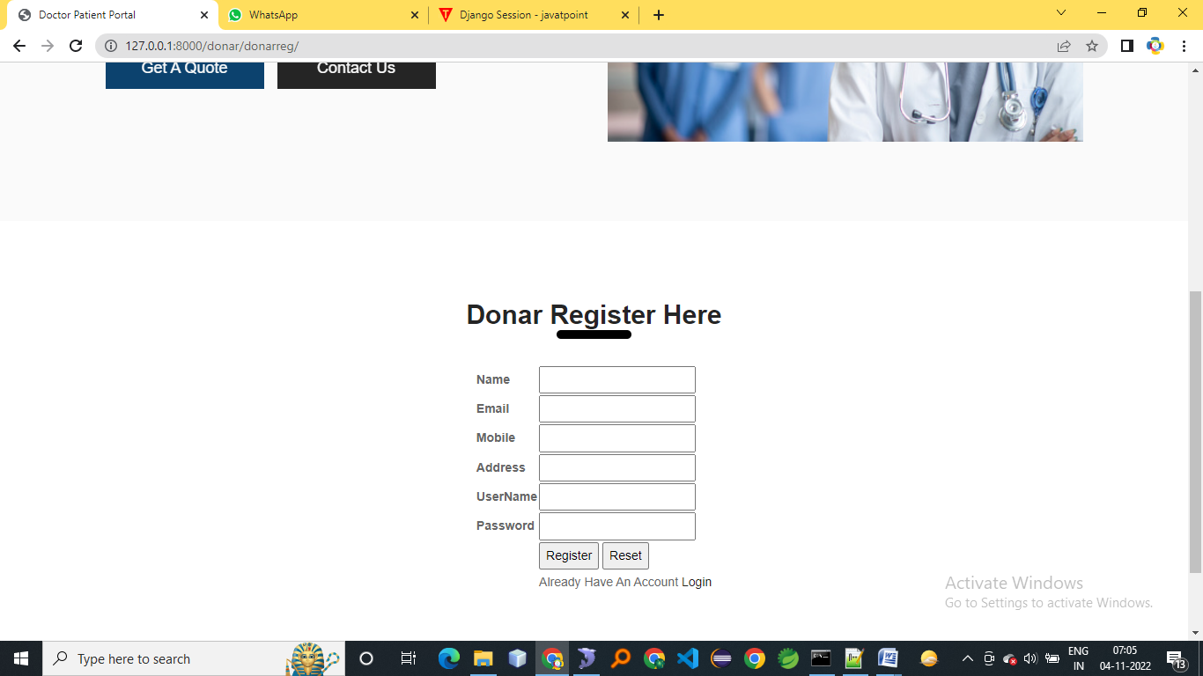
Result
DONAR REGISTRATION

Slide 26
Conclusion
The proposed doctor-patient portal aims to improve healthcare accessibility and quality. Despite current limitations, we hope it will be beneficial to users. Future enhancements will include features like disease alerts, vaccination reminders, and remote healthcare services, further empowering individuals to make informed healthcare decisions.

Slide 27
Future Scope
Convenient access to appointments, records, and doctors
Personalized treatment plans based on health history and preferences
Track health data with connected devices
Virtual visits for remote appointments.
Data analysis for health insights.
Secure messaging for easy communication.

Slide 28
Thank
You

